Slide 1
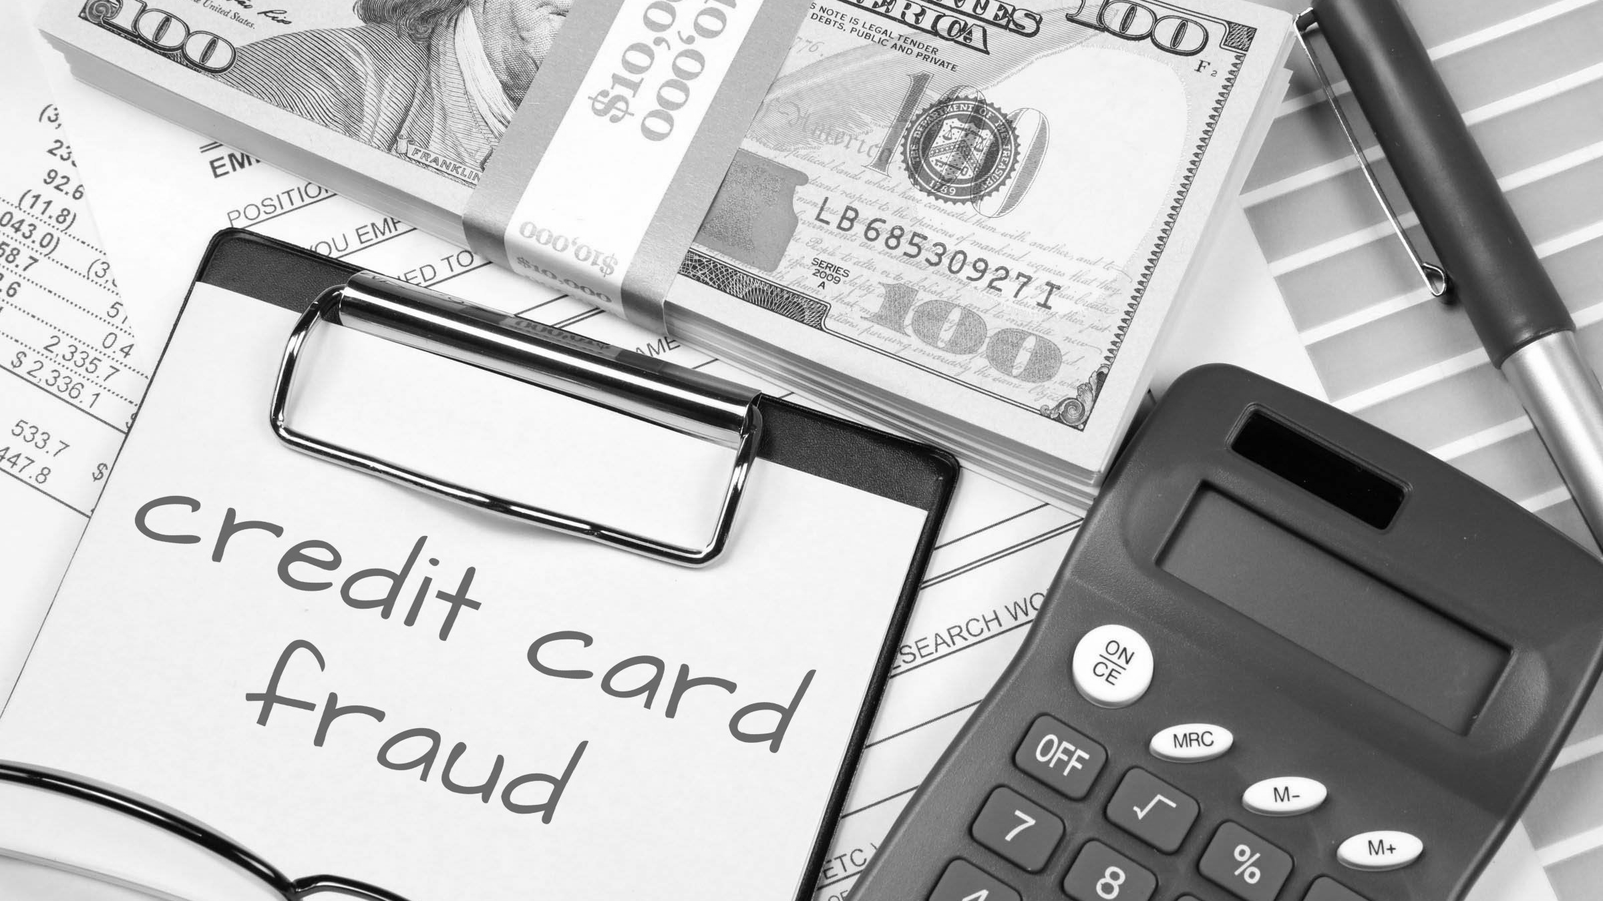
Credit Card Fraud Trends and Predictions
Team 1 Authors:
Ashleigh Bridges, Sean Flinn, Sha’Irene Reid, Rebecca Allison , Mike Bowman

Slide 2
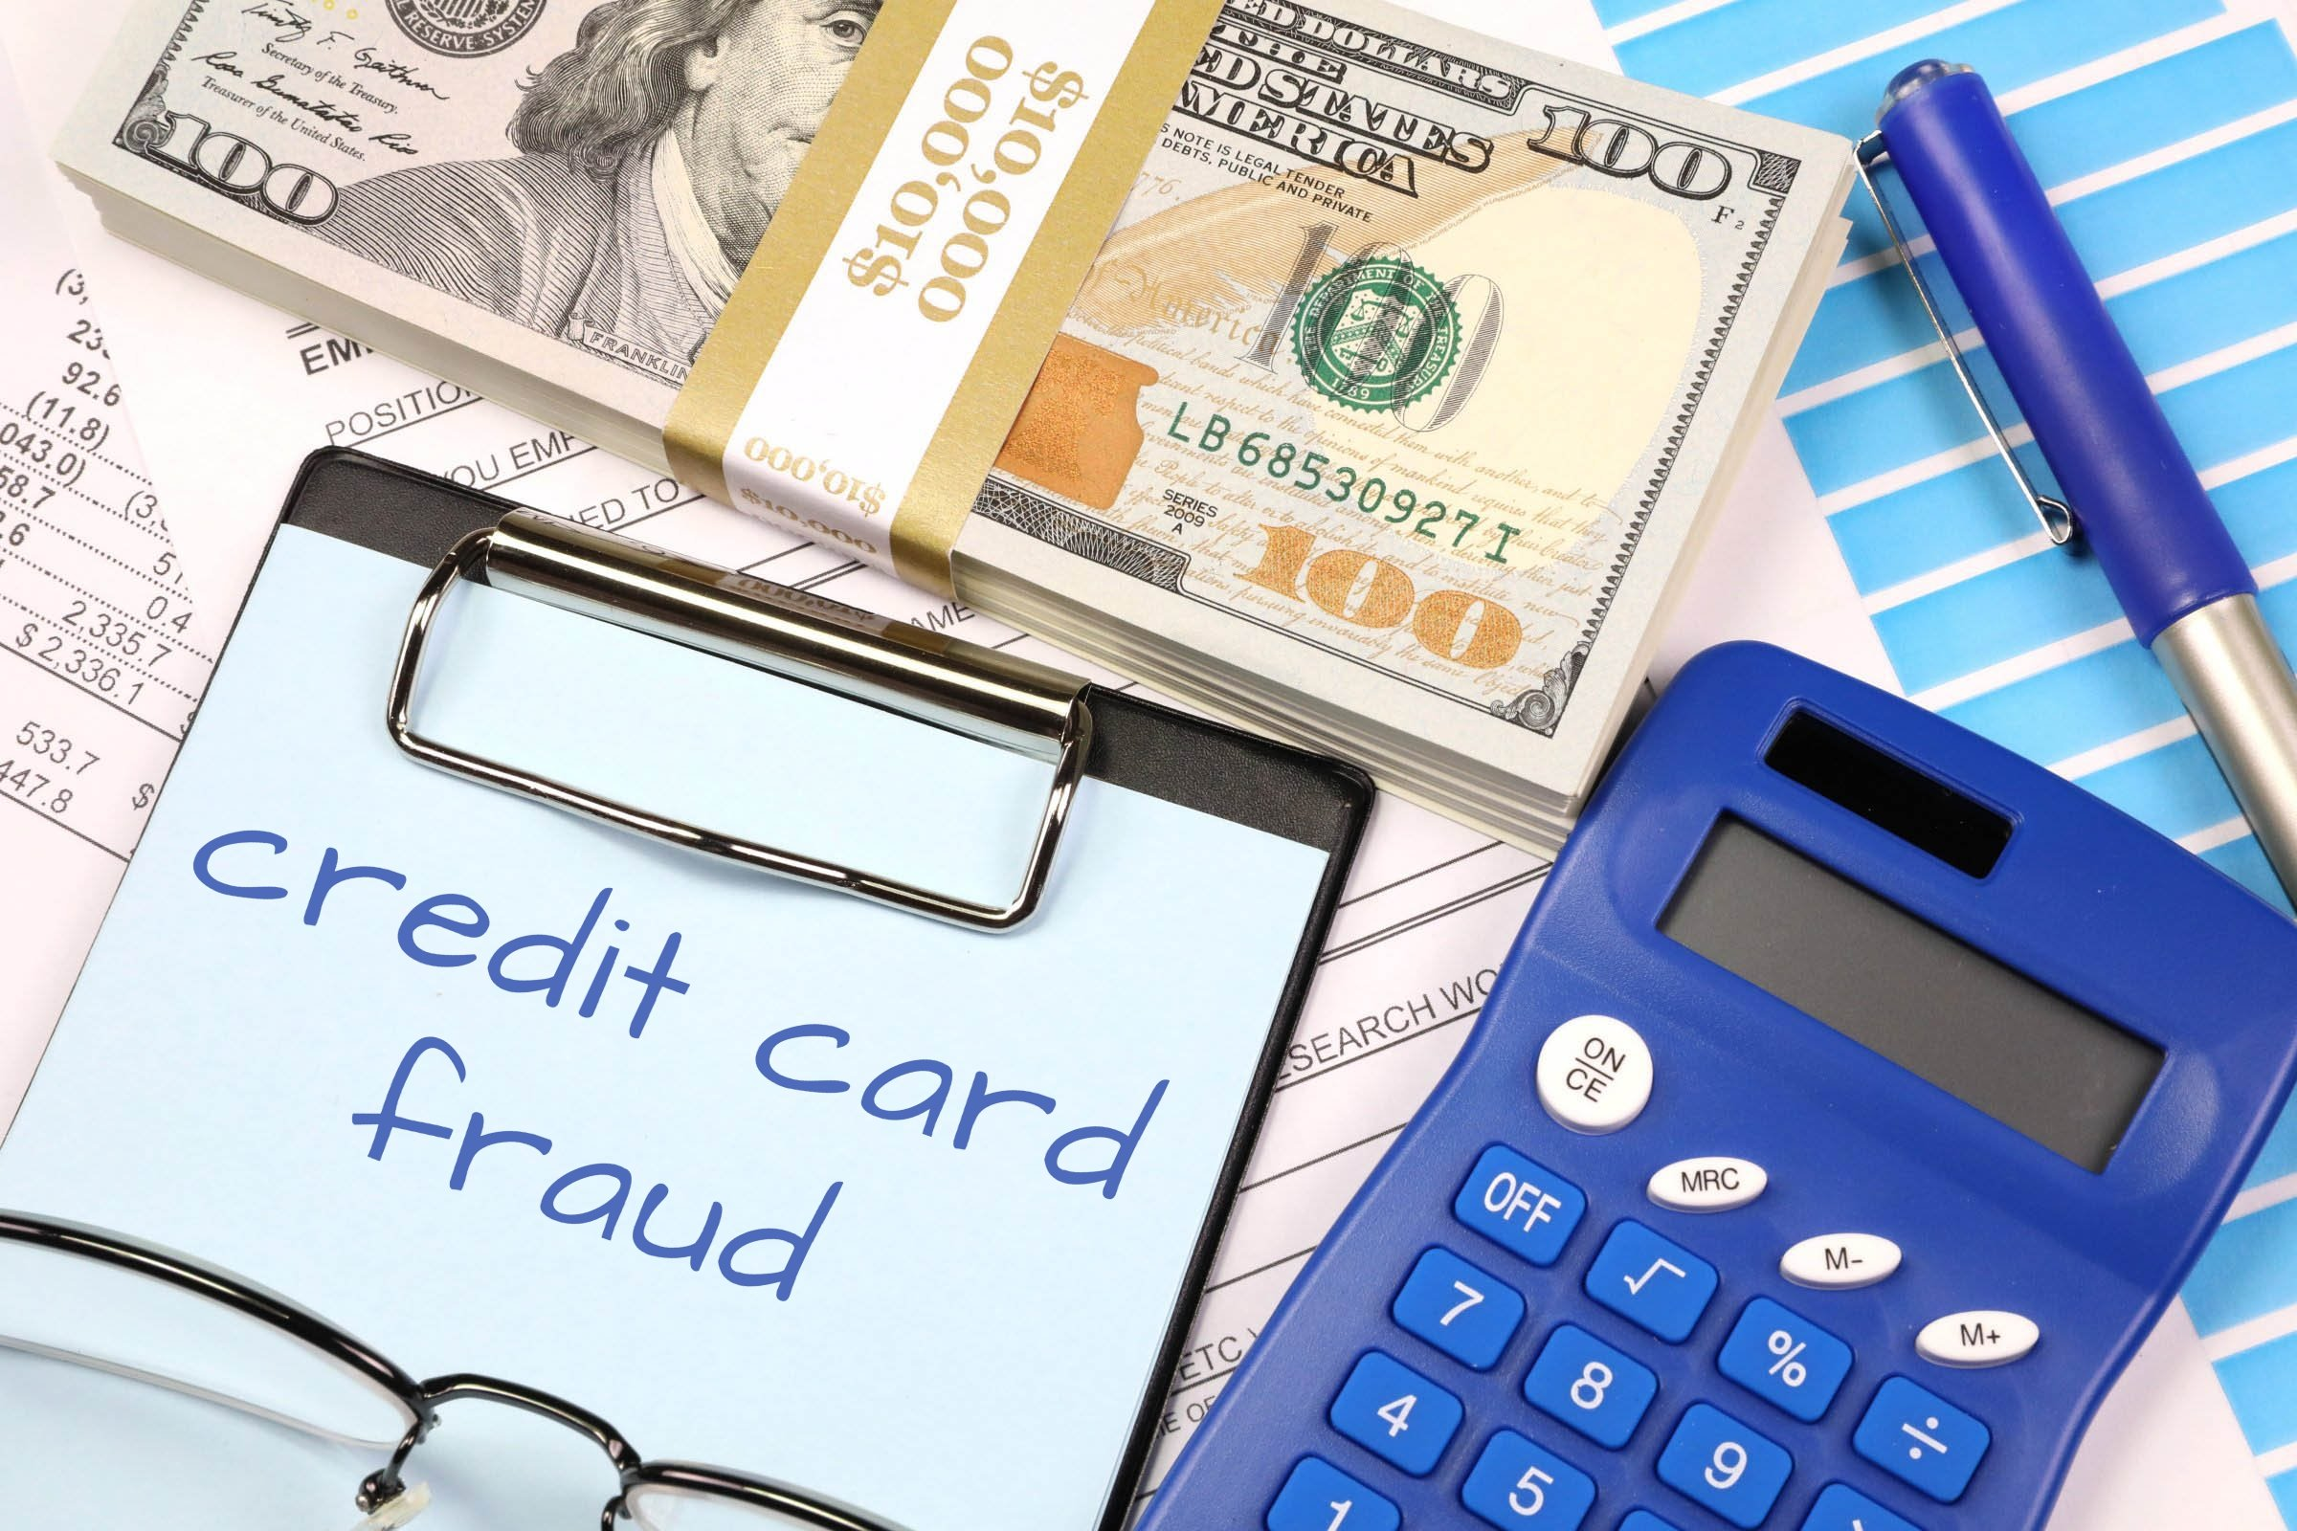
Why did we select Credit Card Fraud as the topic for this project?
We chose this topic due to our team’s background in the financial service sector and two teammates with credit card experience.
Notes:
**Ash Slide**
-Credit card fraud is a very prevalent issue today that has probably affected everyone on this call so we decided to see if we could use the plethora of fraud data out there to see if we could detect any trends that point to higher instances of credit card fraud
-This subject is in our wheelhouse because we all work in the financial services industry, Sean and I both have credit card experience, and Sean has actually worked in the credit card fraud department of a major bank

Slide 3
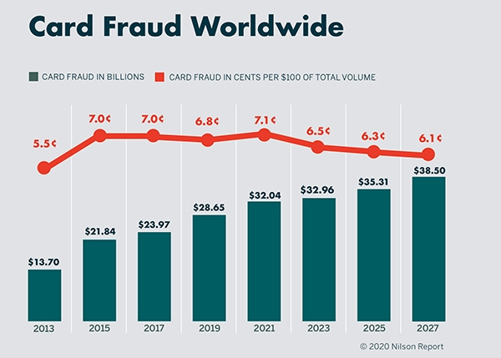
Understanding Credit Card Fraud
Credit card fraud is a global problem and the cost of fraud is rising each year
Financial impacts of fraud can be significant and have downstream impacts
Banks are investing significant time and money in machine learning to help detect and mitigate fraud as quickly as possible
Notes:
-Credit card fraud is a global issue that is only growing as time goes on
-According to a 2021 report , about 50% of all Americans have experienced a fraudulent charge on their credit or debit cards, and more than one in three credit or debit card holders have experienced fraud multiple times. This amounts to 127 million people in the US that have been victims of credit card theft at least once.
-According to one study, for each $1 in a fraudulent transaction, businesses lose $3.75 (LexisNexis)
-Because of the extreme costs to businesses and financial institutions, banks are investing significant resources into fraud detection and prevention, with a large part being machine learning models
-These models have to be extremely accurate to be worthwhile - for me personally, my bank once picked up on a $2 itunes charge
-You would think that would be such a low amount that models wouldn’t be detected but banks have trained these models to pick up on anything that seems odd
**Ash slide***

Slide 4
What is Credit Card Fraud?
Credit card fraud can occur when unauthorized users gain access to an individual’s credit card information in order to make purchases, other transactions, or open new accounts.
Forms:
Lost or stolen cards
Not Received as Issued (Never Received) – Account Takeover
False Application /New Account fraud
Counterfeit / Skimming
Card Not Present fraud (online / phone / mail)
Notes:
Credit card fraud can occur in many forms:
-Card being physically lost or stolen
-New card was never received (possibly intercepted in the mail)
-False application/new account/identity fraud
-Counterfit (skimmers, RFID readers, etc.)
-’Card Not Present’ impersonation (online, phone, mail)

Slide 5

Source of Data
Our Dataset is a simulated credit card transaction dataset, covering the cards of 1000 customers with a pool of 800 merchants.
Data set covers transactions over a full two-year period.
Contains both legitimate and fraudulent transactions.
Link to dataset: https://www.kaggle.com/datasets/kartik2112/fraud-detection
Notes:
**Rebecca
Each transaction was flagged as fraudulent or not fraudulent thus creating the binary dataset we needed for the machine learning model

Slide 6

Questions to be Answered
Are there any trends in the data?
Can any of these trends be used to predict and prevent future fraudulent transactions?
Focus of our Study
Merchants: Which merchants have the most fraud cases?
City/State/Region: Is there are a primary area where fraud occurs?
Age of purchaser: What is the age of purchaser impacted by fraud?
Fraud amounts: What fraud amounts are being incurred?
Transaction Types: What types of transactions are involved with fraud cases?
Notes:
**Rebecca
The primary question we hope to answer is can identified trends in the data, if any, be used to predict credit card fraud
Secondarily, can businesses use the analysis to more quickly identify fraud and reduce/prevent fraud in the future
We focused our trend analysis on features including: Merchant, Region, Age of Purchaser, Fraud $ amounts, and transaction types
Mike will now go into more detail about our Data Exploration phase

Slide 7
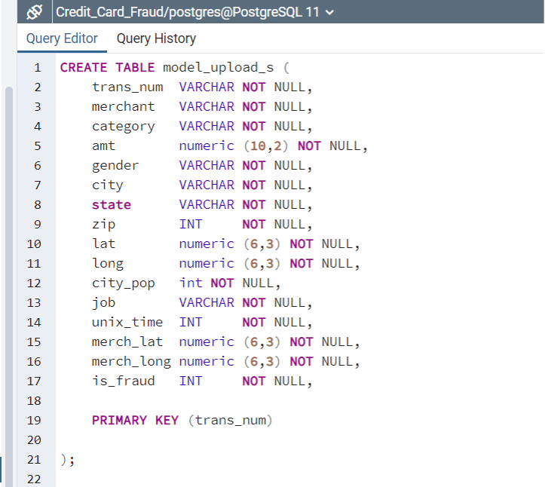
Data Exploration Phase
Kaggle data was inspected, cleaned, analyzed, and separated into two tables:
Model Upload Data: Data used with Machine Learning Models
Notes:
**Mike Slide**
Covers Slides 7-8-9
Prior Intro into Data Analyzation Segment:
1. Data Used: Our dataset from Kaggle.com is a simulated credit card transaction dataset covering the credit cards of 1000 customers from a pool of 800 merchants. The data set covers transactions over a 2 year period covering legitimate as well as fraudulent transactions.
2. Link to Dataset: https://www.kaggle.com/datasets/kartik2112/fraud-detection
Start Here ======================================================================
3. Data Review: The Kaggle data was reviewed and analyzed by our Machine Learning team and placed into 2 separate tables:
4. a. Model_Upload table: Contains those attributes which can be used in machine learning models
5. b. Personal Info table: Contains those attributes which are more personal in nature
6. and is commonly referred to as “P.I”
7. Creation of Database: A database was created in Postgres (named Credit_Card_Fraud) with the 2 tables created with this database.
(Screenshots are included within my ReadMe)
8. Database Schema: A database schema was created which displayed the tables, attributes and appropriate data types and characteristics assigned
(Screenshots are included with my ReadMe)
9. Create Tables: Tables were then created by means of “Create Table” queries within the Credit_Card_Fraud database within Postgres.
10. CSV Files/Upload: Data suiting the appropriate columns were created as CSV files and then uploaded within Postgres to the appropriate 2 tables
11. Sample files: Sample files were created to be placed in GitHub as there is a size restriction on the file that can be placed in there:
(model_upload_s)
(personal_info_s)
12. Data Testing: The data was then tested and reviewed by means of creating joins within the tables and related queries such as performing counts on specific types of data
13. Amazon Web Services: After the review steps outlined above, the 2 tables were then placed in the S3 area within AWS to be used in our machine learning analysis. (Examples of these queries can be found within the project ReadMe)
14. Tableau: Copies of the same 2 files were additionally used for our visualization charts within Tableau
15.
16. Screenshots of the above steps can be viewed at:
17.
18. https://github.com/ashleighbridges/credit_card_fraud/tree/main
a
Prior Intro into Data Analyzation Segment:
1. Data Used: Our dataset from Kaggle.com is a simulated credit card transaction dataset covering the credit cards of 1000 customers from a pool of 800 merchants. The data set covers transactions over a 2 year period covering legitimate as well as fraudulent transactions.
2. Link to Dataset: https://www.kaggle.com/datasets/kartik2112/fraud-detection
Start Here ======================================================================
3. Data Review: The Kaggle data was reviewed and analyzed by our Machine Learning team and placed into 2 separate tables:
4. a. Model_Upload table: Contains those attributes which can be used in machine learning models
5. b. Personal Info table: Contains those attributes which are more personal in nature
6. and is commonly referred to as “P.I”
7. Creation of Database: A database was created in Postgres (named Credit_Card_Fraud) with the 2 tables created with this database.
(Screenshots are included within my ReadMe)
8. Database Schema: A database schema was created which displayed the tables, attributes and appropriate data types and characteristics assigned
(Screenshots are included with my ReadMe)
9. Create Tables: Tables were then created by means of “Create Table” queries within the Credit_Card_Fraud database within Postgres.
10. CSV Files/Upload: Data suiting the appropriate columns were created as CSV files and then uploaded within Postgres to the appropriate 2 tables
11. Sample files: Sample files were created to be placed in GitHub as there is a size restriction on the file that can be placed in there:
(model_upload_s)
(personal_info_s)
12. Data Testing: The data was then tested and reviewed by means of creating joins within the tables and related queries such as performing counts on specific types of data
13. Amazon Web Services: After the review steps outlined above, the 2 tables were then placed in the S3 area within AWS to be used in our machine learning analysis. (Examples of these queries can be found within the project ReadMe)
14. Tableau: Copies of the same 2 files were additionally used for our visualization charts within Tableau
15.
16. Screenshots of the above steps can be viewed at:
17.
18. https://github.com/ashleighbridges/credit_card_fraud/tree/main
a

Slide 8
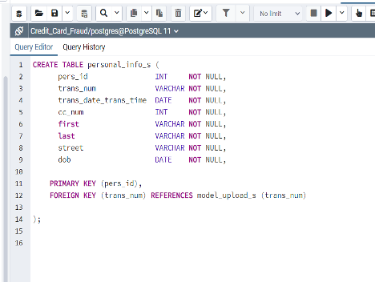
Data Exploration Phase (cont’d)
Second table created - Personal Information Data
Data that is typically seen as “PI” in most financial institutions
Notes:
**Mike**

Slide 9
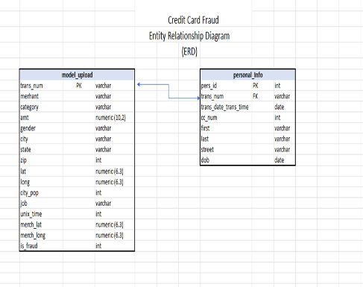
Creation of Entity Relationship Diagram
Data was tested by means of joining tables and performing counts of the relevant remaining data.
The Model Upload table data was then uploaded into Amazon Web Services in a S3 bucket for the machine learning analyzation portion of the project
Notes:
**Mike**

Slide 10
Analysis Phase
The purpose of the analysis was to predict if a transaction is one of two values: Fraudulent or Non-Fraudulent
Logistic Regression model was initial focus due to this binary outcome
Models tested included SMOTE, Random Undersampling, Random Oversampling, and Random Forest
Notes:
**Sean**
Goal is to ID fraud
How best to do it (look at data, use industry knowledge, and results to determine this)
Lots of data lots of rows no way a human can do it

Slide 11
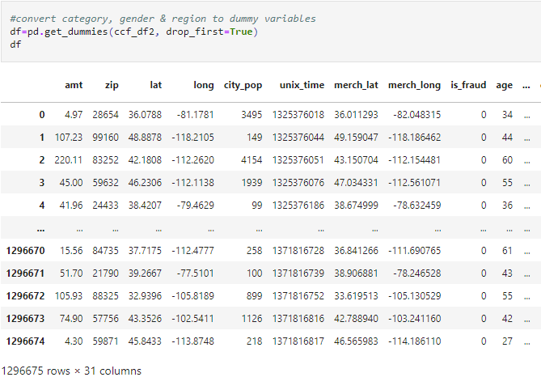
Machine Learning
Preprocessing
23 Columns of Data
Target
Categorical Values
Combined Column and DOB
Trans_Date_Trans_Time
DOB
State
Bucket to Regions
Encode remaining categorical data
SCALE
Train Test Split
Notes:
23 columns of data with over a Million rows of data. Initially this is a LOT but hey more for the machine to learn and consider.
As we are attempting to predict fraud we are targeting the Is Fraud column which is a simple 0 - for not fraud and 1 for fraud.
Next we need to take a look at our categorical columns
11 columns where 8 of them have a minimum of 350+ unique values
Bucketing will overfit and many are not true value add (name, street, city, etc)
Trans column was combine of values that could provide more value. Create code in order to split this out and make them integer values
DOB was a categorical, so changed this to integer values
States was 51 categorical, bucket to Regions to simplify the code
Kept all integer values and reduced categorical to gender, and trans category
Forgot to Scale initially and had very different results. Found in an iteration and updated the code Results were on the other slide

Slide 12
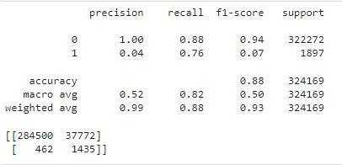
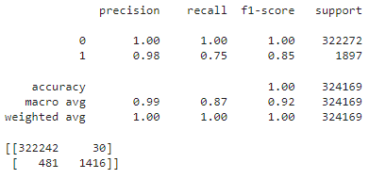
Machine Learning
Methods and Results
Logistic Regression
SMOTE vs Random Forest
Accuracy, Precision, and Sensitivity
Notes:
Binary outcomes - so Logistical Regression
Importance of Precision and Sensitivity
SMOTE vs Random Forrest
Oversample - due to imbalance results
Forest - Robust to outliers and run EFFICIENTLY
Results

Slide 13
Can it be Better?
Methods - SMOTE, Random UnderSampling, Random OverSampling, Random Forest
Consider Spending History
Add weight to change in spend patterns
Reduce Features - Amount, Spend History, Age, Time, Day, Month, and Region
Results
Minimal increase in identified fraud.
Significant increase in false negatives.
Notes:
Can it be better?
Overall Random Forest was better than I expected.
Based on industry knowledge a dormant card that is suddenly can indicate fraud.
New features
Results - most had an increase false negatives with MINIMAL increase in found fraud

Slide 14
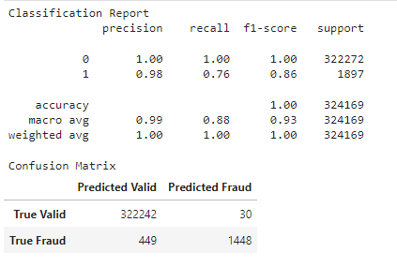
Final Solution
Method - Random Forest
Focused Features - Amt, Zip, City Population, Spend Pattern, Time, Day, Month, Category of Transaction, Gender, Region
Notes:
Final results was the random forest with updated features
True fraud cases increased 32.
1 in 4 instances of fraud undetected but potentially offset the potential losses
Hand to Sha to discuss Tableau.

Slide 15
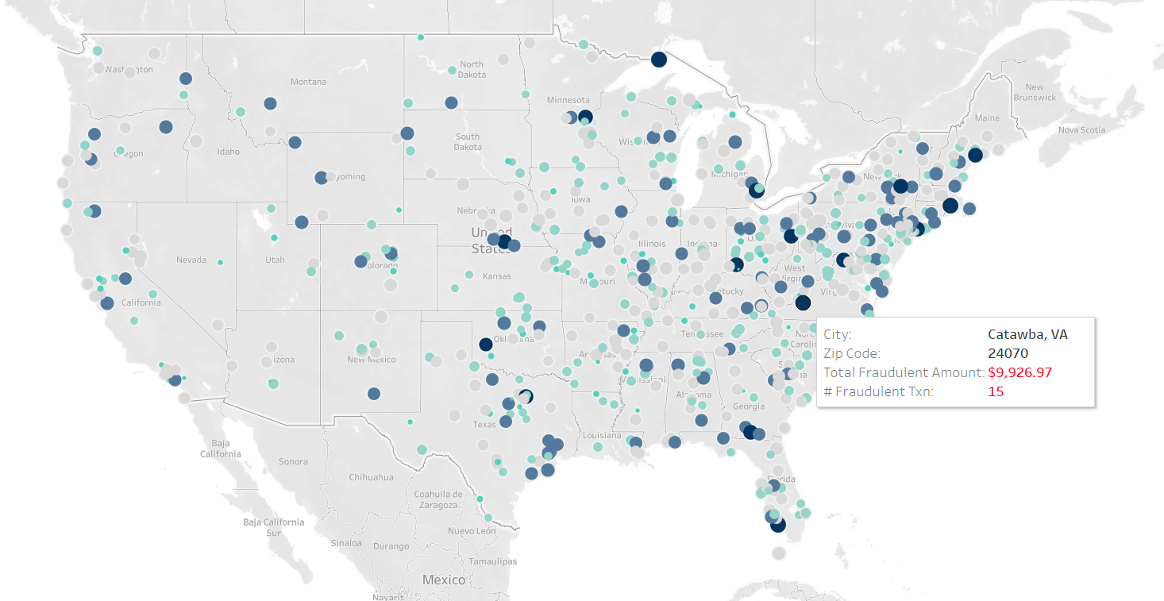
Tableau Dashboard
Create visualization from worksheets and Dashboards to visualize credit card fraud
Be able to locate trends
Credit Card Fraud Visualizations
Notes:
**Sha**
To be able to provide visualization and trends of credit card fraud from 2019-2020 we used Tableau Dashboard
We were able to create worksheets and dashboard in order to showcase the difference trends and Merchant categories that are affected.
There is also a link provided for you to take a look at our visualizations.
We will take a quick dive into some worksheets and dashboard through our StoryBoard.

Slide 16
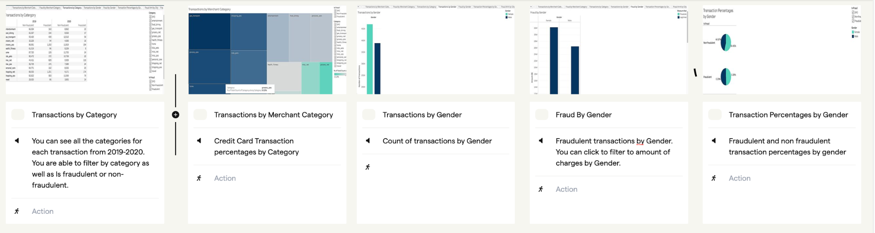
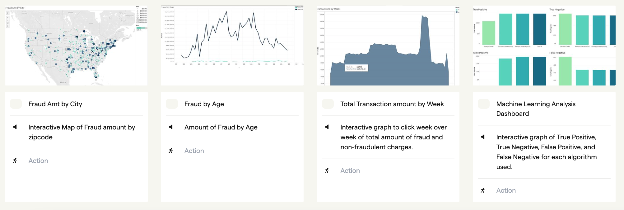
StoryBoard
Notes:
**Sha**
Our Storyboard shows our Credit Credit Card Fraud Tableau Visualizations. Each Visualization is interactive. This will help you get a better picture of ways we can take a deep dive into credit card fraud
Transactions by Category
Able to view all transaction by category for 2019-2020. You can filter by category, or if transaction is fraudulent or not.
Can also click on the category to highlight the attributes of that category
Transaction Percentages of each Category
You can hover over each sectionto get the transaction percentage of that category. You can click on or filter a category as well as fraud or non fraudulent transactions
Transactions by Gender
Count of transaction by Female or Male
Able to filter by Gender
Fraud By Gender
Determine fraud by gender.
Can filter by legitimate transaction or fraudulent transaction
Transaction Percentages by Gender
Fraudulent and non fraudulent transaction percentages by gender.
Can filter or click on gender
Can filter by fraudulent of non-fraudulent
Fraud Amount by City
Interactive Map to click on to see fraudulent charges by city.
You can click and hover over each circle for:
City
Zip Code
Total Fraudulent Amt
Total Transaction
Fraud by Age
Amount of fraud by age
One line represents legitimate transactions while the other represents fraud. You can hover over each line for age and total transaction amount
Total Transaction amount by week
Interactive graph to click week over week of total amount of fraud and non fraud transactions
You can hover over graph to get pop up of week and total amount of transaction for that week
Machine Learning Analysis
Dashboard to show machine learning analysis and what algorithms were used

Slide 17

Technologies
Languages
Tools
Algorithms
Entity Relationship Diagram
Jupyter Notebook
AWS
Python
Tableau
PostgreSQL
GitHub
SMOTE
Random Forest
Random Oversampling
Random Under Sampling
Notes:
**Sha**
Here is the summary of the Technologies, Languages, Tools and Algorithms we used throughout each phase of our analysis.

Slide 18
Questions?

